Slide 1
SAP EWM EXTENDED WAREHOUSE MANAGEMENT TRAINING
AnubhavTrainings.com
www.anubhavtrainings.com

Slide 2

SAP EWM TRAINING
BY:-
Mr. Bijoy
www.anubhavtrainings.com
Notes:
https://unsplash.com/photos/uXB-7la5vqA

Slide 3
SAP EWM TRAINING (Day 03)
AnubhavTrainings.com

Slide 4
SAP MM & EWM Org Structure
Org structure understanding
Define Plant
Storage locations
ERP Warehouse number
EWM Org structure
Define Storage types, Storage Section & Storage bins

Slide 5
EWM RESOURCE MANAGEMENT
Contents
DEFINE RESOURCE TYPE
- BIN ACCESS TYPE
- HU TYPE GROUPS
DEFINE QUEUE TYPE
DEFINE QUEUES
DEFINE QUEUE DETERMINATION CRITERIA
DEFINE QUEUE ACCESS SEQUENCE
MAINTAIN MASTER DATA FOR RESOURCE MANAGEMENT
- RESOURCE GROUP
- MAINTAIN RESOURCE
- ASSIGN USER TO RESOURCE

Slide 6
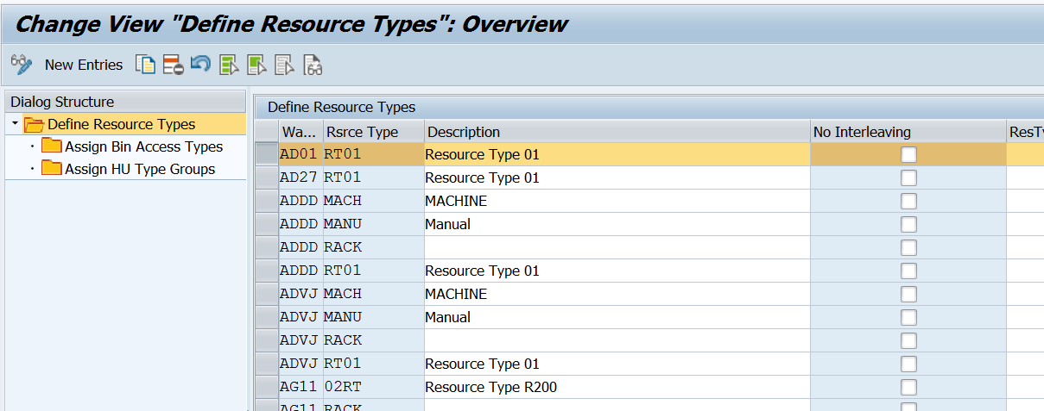
DEFINE RESOURCE TYPE
A resource type is a grouping of resources (RF device) with similar technical or physical qualifications.
Extended Warehouse Management > Cross-Process Settings > Resource Management > Define Resource Types

Slide 7
BIN ACCESS TYPE
Bin access type (Can be Fast or slow moving bin)
It will required when resource type (RT01) only need to work for specific storage type
(it can be mantained in /scwm/ls01)
Hu Type Groups
HU Type groups (Pallet level or Wooden level HU)
It will be required when HU levels are needs to be separated as per storage type.

Slide 8
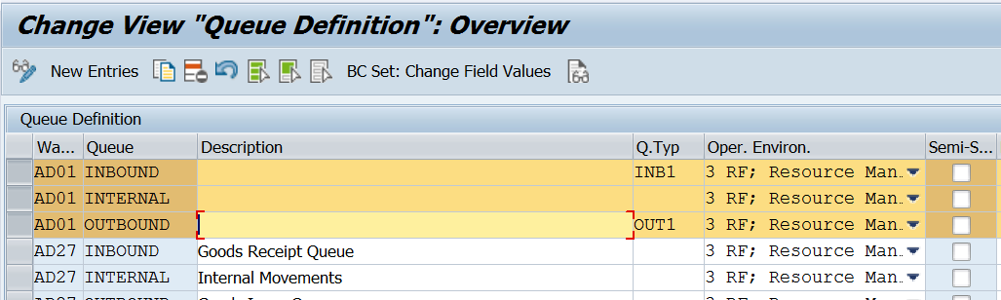
DEFINE QUEUES
A queue is a logical file to which warehouse tasks (WTs) for processing are assigned. Queues define movements by which work in the warehouse is managed and assigned.
Extended Warehouse Management > Cross-Process Settings > Resource Management > Define Queues
www.anubhavtrainings.com

Slide 9
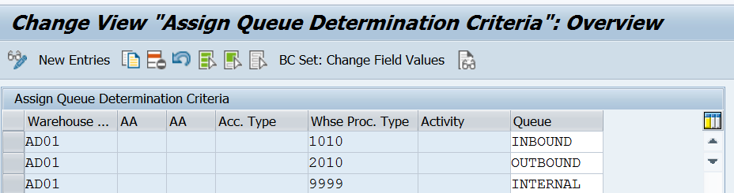
DEFINE QUEUE DETERMINATION CRITERIA
In this customizing activity, Queue will be assigned to Warehouse number with WH process type
www.anubhavtrainings.com

Slide 10
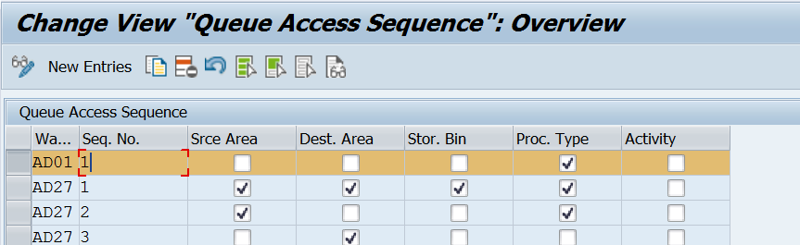
DEFINE QUEUE ACCESS SEQUENCE
In this customizing activity, Queue access sequence must be set at some level (as shown in below fig)
www.anubhavtrainings.com

Slide 11
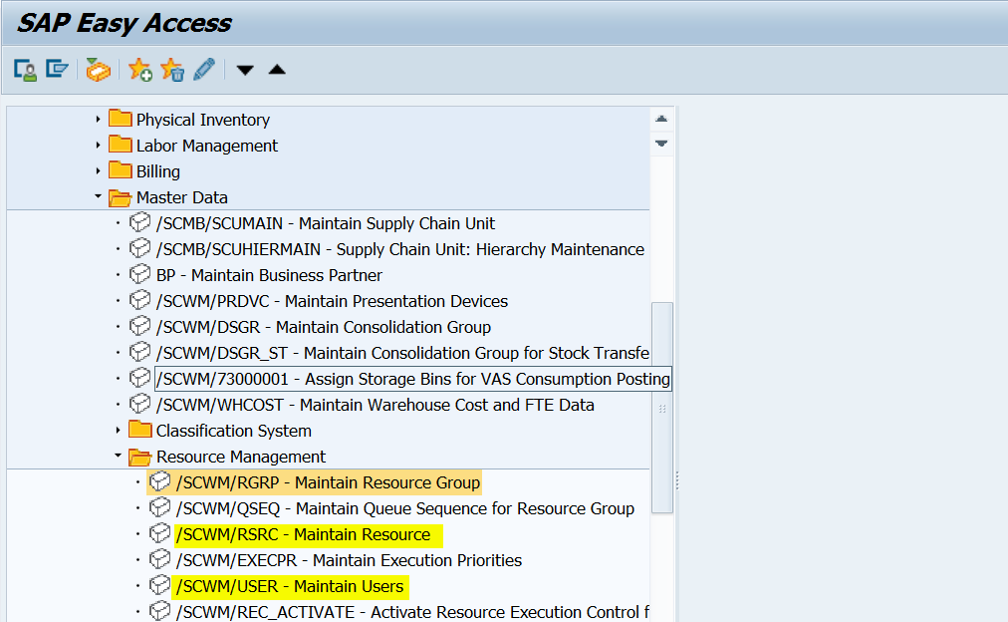
Maintain Master Data For Resource Management
www.anubhavtrainings.com

Slide 12
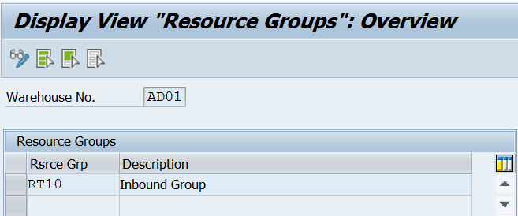
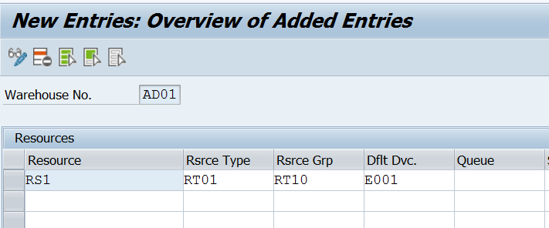
Resource Group
Maintain Resource (/Scwm/Rsrc)
www.anubhavtrainings.com

Slide 13
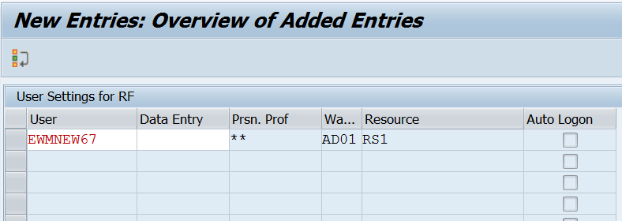
ASSIGN USER TO RESOURCE (/SCWM/USER)
www.anubhavtrainings.com

Slide 14


End of Session 03
www.anubhavtrainings.com

Slide 15

FEEL FREE TO ASK QUESTIONS

Slide 16

Feedback

Slide 17
THANK
YOU

Slide 18

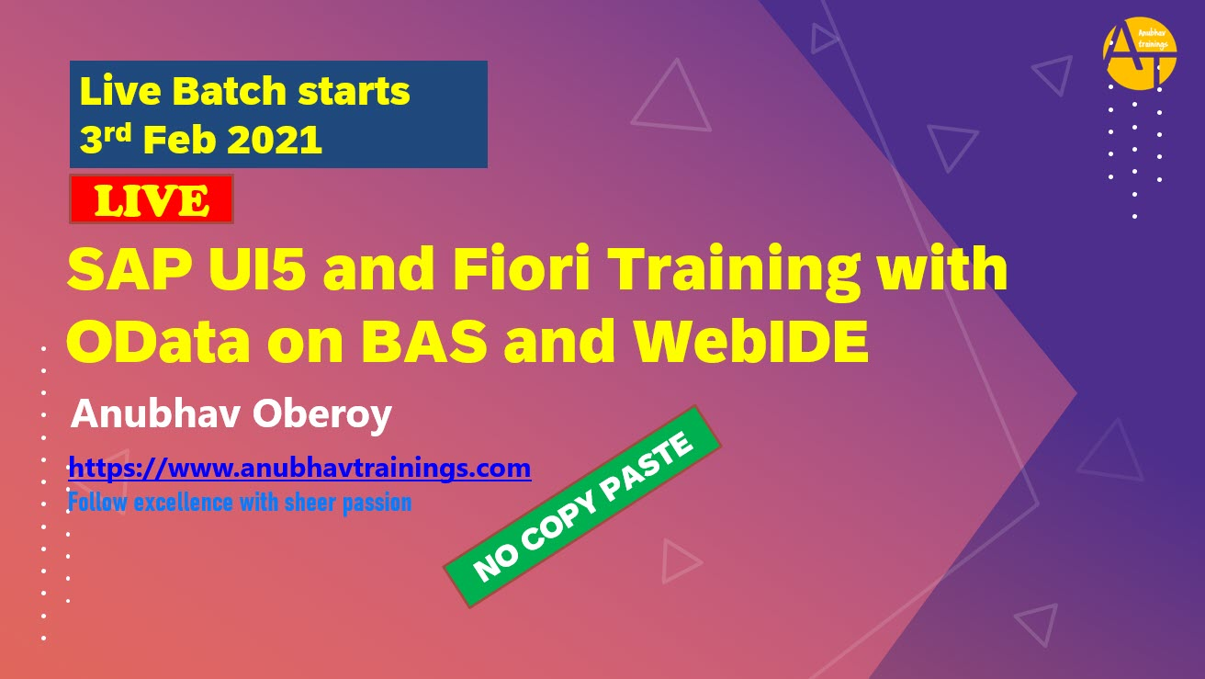

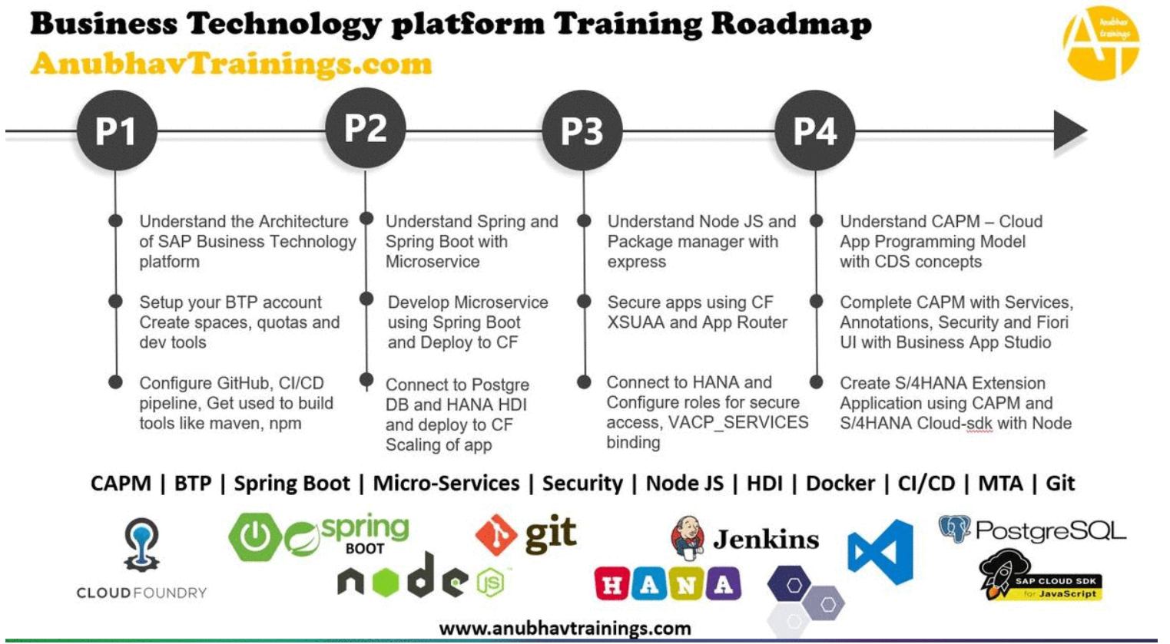
More from AnubhavTrainings.com

Slide 19






We’re committed to empower you to be
#FutureReady
through powerful training solutions.
We build the workforce of the future.
250+
Corporate Clients
30,000+
Learners Trained
25000+
Learners Placed
FREE WEBINARS
Sign up for free webinars with industry experts every fortnight!
Enroll Now!

Slide 20
FREE WEBINARS
Sign up for free webinars with industry experts every fortnight!
Contact us today!
www.anubhavtrainings.com

